Slide 1
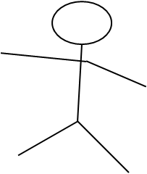




FB
TB
Look, a toma!
Look, a toma!
transformation
transformation
I‘ll get that toma!
I‘ll get that toma!
Test
DV
Where does child expect protagonist to go? → as indicated, e.g. in sponatenous assistance
removing obstacles on the way to table / box → fix railroads
etc.

Slide 2
Buttelmann et al./Southgate et al. follow-up → simplified: 1 transformation
FB
TB
Unusal novel container
Unusal novel container
transformation
transformation
removed
Ah, there‘s the toma
removed
Ah, there‘s the toma
Can you give me the toma
Can you give me the toma
Test

Slide 3
Buttelmann et al. follow-up Option #1
FB
TB
transformation
transformation
Test
tries to open
tries to open
DV
Will child give Id. 1 (+ show transformation) OR help open the box?

Slide 4
Buttelmann et al./Southgate et al. follow-up → simplified: 1 transformation + 2 boxes
FB
TB
B1
B2
B1
B2
transformation
transformation
B1
B2
B1
B2
tries to open
tries to open
Test
B1
B2
B1
B2
DV
Does the child think (a) the protagonist is looking for Id.1in B1 OR (b) she knows Id.1=Id.2 is not in B1 anymore and must therefore look for something else or just want to open the box?
→ As indicated in their helping to open B1/B2 (e.g. with keys only the child knows how to operate…)

